Slide 1
DATA REPRESENTATION

Slide 2
Number Systems
Decimal numbers
Binary numbers

Slide 3
Number Systems
Decimal numbers
Binary numbers

Slide 4
Powers of Two
2⁰ =
2¹ =
2² =
2³ =
2⁴ =
2⁵ =
2⁶ =
2⁷ =
2⁸ =
2⁹ =
2¹⁰ =
2¹¹ =
2¹² =
2¹³ =
2¹⁴ =
2¹⁵ =

Slide 5
Powers of Two
2⁰ = 1
2¹ = 2
2² = 4
2³ = 8
2⁴ = 16
2⁵ = 32
2⁶ = 64
2⁷ = 128
Handy to memorize up to 2⁹
2⁸ = 256
2⁹ = 512
2¹⁰ = 1024
2¹¹ = 2048
2¹² = 4096
2¹³ = 8192
2¹⁴ = 16384
2¹⁵ = 32768

Slide 6
Number Conversion
Decimal to binary conversion:
Convert 10011₂ to decimal
Decimal to binary conversion:
Convert 47₁₀ to binary

Slide 7
Number Conversion
Decimal to binary conversion:
Convert 10011₂ to decimal
16×1 + 8×0 + 4×0 + 2×1 + 1×1 = 19₁₀
Decimal to binary conversion:
Convert 47₁₀ to binary
32×1 + 16×0 + 8×1 + 4×1 + 2×1 + 1×1 = 101111₂

Slide 8
Binary Values and Range
N-digit decimal number
How many values?
Range?
Example: 3-digit decimal number:
N-bit binary number
How many values?
Range:
Example: 3-digit binary number:

Slide 9
Binary Values and Range
N-digit decimal number
How many values? 10^{N}
Range? [0, 10^{N} - 1]
Example: 3-digit decimal number:
10³ = 1000 possible values
Range: [0, 999]
N-bit binary number
How many values? 2^{N}
Range: [0, 2^{N} - 1]
Example: 3-digit binary number:
2³ = 8 possible values
Range: [0, 7] = [000₂ to 111₂]

Slide 10
Hexadecimal Numbers
Hex Digit | Decimal Equivalent | Binary Equivalent
0 | 0
1 | 1
2 | 2
3 | 3
4 | 4
5 | 5
6 | 6
7 | 7
8 | 8
9 | 9
A | 10
B | 11
C | 12
D | 13
E | 14
F | 15

Slide 11
Hexadecimal Numbers
Hex Digit | Decimal Equivalent | Binary Equivalent
0 | 0 | 0000
1 | 1 | 0001
2 | 2 | 0010
3 | 3 | 0011
4 | 4 | 0100
5 | 5 | 0101
6 | 6 | 0110
7 | 7 | 0111
8 | 8 | 1000
9 | 9 | 1001
A | 10 | 1010
B | 11 | 1011
C | 12 | 1100
D | 13 | 1101
E | 14 | 1110
F | 15 | 1111

Slide 12
Hexadecimal Numbers
Base 16
Shorthand for binary

Slide 13
Hexadecimal to Binary Conversion
Hexadecimal to binary conversion:
Convert 4AF₁₆ (also written 0x4AF) to binary
Hexadecimal to decimal conversion:
Convert 0x4AF to decimal

Slide 14
Hexadecimal to Binary Conversion
Hexadecimal to binary conversion:
Convert 4AF₁₆ (also written 0x4AF) to binary
0100 1010 1111₂
Hexadecimal to decimal conversion:
Convert 4AF₁₆ to decimal
16²×4 + 16¹×10 + 16⁰×15 = 1199₁₀

Slide 15
Bits, Bytes, Nibbles…
Bits
Bytes & Nibbles
Bytes

Slide 16
Large Powers of Two
2¹⁰ = 1 kilo ≈ 1000 (1024)
2²⁰ = 1 mega ≈ 1 million (1,048,576)
2³⁰ = 1 giga ≈ 1 billion (1,073,741,824)

Slide 17
Estimating Powers of Two
What is the value of 2²⁴?
How many values can a 32-bit variable represent?

Slide 18
Estimating Powers of Two
What is the value of 2²⁴?
2⁴ × 2²⁰ ≈ 16 million
How many values can a 32-bit variable represent?
2² × 2³⁰ ≈ 4 billion

Slide 19
Addition
Decimal
Binary

Slide 20
Addition
Decimal
Binary

Slide 21
Binary Addition Examples
Add the following 4-bit binary numbers
Add the following 4-bit binary numbers

Slide 22
Binary Addition Examples
Add the following 4-bit binary numbers
Add the following 4-bit binary numbers
Overflow!

Slide 23
Overflow
Digital systems operate on a fixed number of bits
Overflow: when result is too big to fit in the available number of bits
See previous example of 11 + 6

Slide 24
Signed Binary Numbers
Sign/Magnitude Numbers
Two’s Complement Numbers

Slide 25
Sign/Magnitude Numbers
1 sign bit, N-1 magnitude bits
Sign bit is the most significant (left-most) bit
Positive number: sign bit = 0
Negative number: sign bit = 1
Example, 4-bit sign/mag representations of ± 6:
+6 =
- 6 =
Range of an N-bit sign/magnitude number:

Slide 26
Sign/Magnitude Numbers
1 sign bit, N-1 magnitude bits
Sign bit is the most significant (left-most) bit
Positive number: sign bit = 0
Negative number: sign bit = 1
Example, 4-bit sign/mag representations of ± 6:
+6 = 0110
- 6 = 1110
Range of an N-bit sign/magnitude number:
[-(2^{N-1}-1), 2^{N-1}-1]

Slide 27
Sign/Magnitude Numbers
Problems:
Addition doesn’t work, for example -6 + 6:
1110
+ 0110
10100 (wrong!)
Two representations of 0 (± 0):
1000
0000

Slide 28
Two’s Complement Numbers
Don’t have same problems as sign/magnitude numbers:
Addition works
Single representation for 0

Slide 29
Two’s Complement Numbers
Msb has value of -2^{N-1}
Most positive 4-bit number:
Most negative 4-bit number:
The most significant bit still indicates the sign (1 = negative, 0 = positive)
Range of an N-bit two’s comp number:

Slide 30
Two’s Complement Numbers
Msb has value of -2^{N-1}
Most positive 4-bit number: 0111
Most negative 4-bit number: 1000
The most significant bit still indicates the sign (1 = negative, 0 = positive)
Range of an N-bit two’s comp number:
[-(2^{N-1}), 2^{N-1}-1]

Slide 31
“Taking the Two’s Complement”
Flip the sign of a two’s complement number
Method:
Invert the bits
Add 1
Example: Flip the sign of 3₁₀ = 0011₂

Slide 32
“Taking the Two’s Complement”
Flip the sign of a two’s complement number
Method:
Invert the bits
Add 1
Example: Flip the sign of 3₁₀ = 0011₂
1100
+ 1
1101 = -3₁₀

Slide 33
Two’s Complement Examples
Take the two’s complement of 6₁₀ = 0110₂
What is the decimal value of 1001₂?

Slide 34
Two’s Complement Examples
Take the two’s complement of 6₁₀ = 0110₂
1001
+ 1
1010₂ = -6₁₀
What is the decimal value of the two’s complement number 1001₂?
0110
+ 1
0111₂ = 7₁₀, so 1001₂ = -7₁₀

Slide 35
Two’s Complement Addition
Add 6 + (-6) using two’s complement numbers
Add -2 + 3 using two’s complement numbers

Slide 36
Two’s Complement Addition
Add 6 + (-6) using two’s complement numbers
Add -2 + 3 using two’s complement numbers

Slide 37
Increasing Bit Width
Extend number from N to M bits (M > N) :
Sign-extension
Zero-extension

Slide 38
Sign-Extension
Sign bit copied to MSBs
Number value is same
Example 1:
4-bit representation of 3 = 0011
8-bit sign-extended value: 00000011
Example 2:
4-bit representation of -5 = 1011
8-bit sign-extended value: 11111011

Slide 39
Zero-Extension
Zeros copied to MSBs
Value changes for negative numbers
Example 1:
4-bit value = 0011₂ = 3₁₀
8-bit zero-extended value: 00000011 = 3₁₀
Example 2:
4-bit value = 1011 = -5₁₀
8-bit zero-extended value: 00001011 = 11₁₀

Slide 40
Number System Comparison
Number System | Range
Unsigned | [0, 2^{N}-1]
Sign/Magnitude | [-(2^{N-1}-1), 2^{N-1}-1]
Two’s Complement | [-2^{N-1}, 2^{N-1}-1]
For example, 4-bit representation:

Slide 41
ASCII Code
American Standard Code for Information Interchange
Each text character has unique byte value
For example, S = 0x53, a = 0x61, A = 0x41
Lower-case and upper-case differ by 0x20 (32)

Slide 42
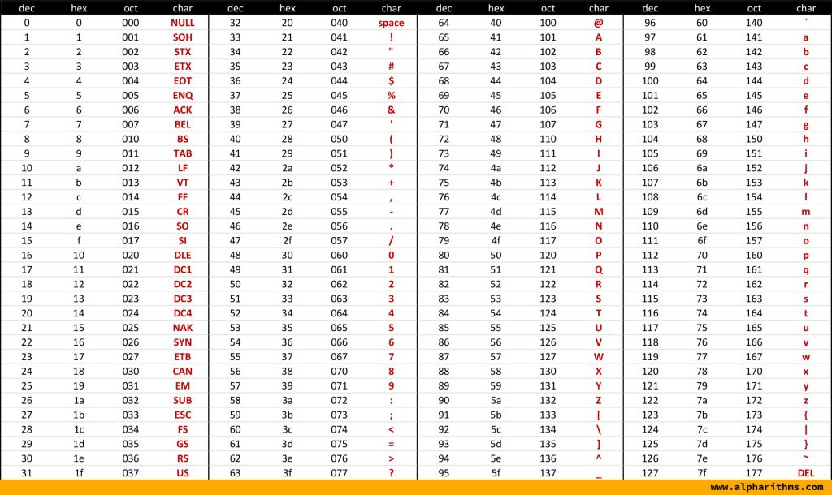
Cast of Characters

Slide 43
Number Systems
Numbers we can represent using binary representations
Positive numbers
Unsigned binary
Negative numbers
Two’s complement
Sign/magnitude numbers
What about fractions?

Slide 44
Numbers with Fractions
Two common notations:
Fixed-point: binary point fixed
Floating-point: binary point floats to the right of the most significant 1

Slide 45
Fixed-Point Numbers
6.75 using 4 integer bits and 4 fraction bits:
Binary point is implied
The number of integer and fraction bits must be agreed upon beforehand

Slide 46
Fixed-Point Number Example
Represent 7.5₁₀ using 4 integer bits and 4 fraction bits.

Slide 47
Fixed-Point Number Example
Represent 7.5₁₀ using 4 integer bits and 4 fraction bits.
01111000

Slide 48
Signed Fixed-Point Numbers
Representations:
Sign/magnitude
Two’s complement
Example: Represent -7.5₁₀ using 4 integer and 4 fraction bits
Sign/magnitude:
Two’s complement:

Slide 49
Signed Fixed-Point Numbers
Representations:
Sign/magnitude
Two’s complement
Example: Represent -7.5₁₀ using 4 integer and 4 fraction bits
Sign/magnitude:
11111000

Slide 50
Floating-Point Numbers
Binary point floats to the right of the most significant 1
Similar to decimal scientific notation
For example, write 273₁₀ in scientific notation:
273 = 2.73 × 10²
In general, a number is written in scientific notation as:
± M × B^{E}
M = mantissa
B = base
E = exponent
In the example, M = 2.73, B = 10, and E = 2

Slide 51
Floating-Point Numbers
Example: represent the value 228₁₀ using a 32-bit floating point representation
We show three versions –final version is called the IEEE 754 floating-point standard

Slide 52
Floating-Point Representation 1
Convert decimal to binary (don’t reverse steps 1 & 2!):
228₁₀ = 11100100₂
Write the number in “binary scientific notation”:
11100100₂ = 1.11001₂ × 2⁷
Fill in each field of the 32-bit floating point number:
The sign bit is positive (0)
The 8 exponent bits represent the value 7
The remaining 23 bits are the mantissa

Slide 53
Floating-Point Representation 2
First bit of the mantissa is always 1:
228₁₀ = 11100100₂ = 1.11001 × 2⁷
So, no need to store it: implicit leading 1
Store just fraction bits in 23-bit field

Slide 54
Floating-Point Representation 3
Biased exponent: bias = 127 (01111111₂)
Biased exponent = bias + exponent
Exponent of 7 is stored as:
127 + 7 = 134 = 0x10000110₂
The IEEE 754 32-bit floating-point representation of 228₁₀
in hexadecimal: 0x43640000

Slide 55
Floating-Point Example
Write -58.25₁₀ in floating point (IEEE 754)

Slide 56
Floating-Point Example
Write -58.25₁₀ in floating point (IEEE 754)
Convert decimal to binary:
58.25₁₀ = 111010.01₂
Write in binary scientific notation:
1.1101001 × 2⁵
Fill in fields:
Sign bit: 1 (negative)
8 exponent bits: (127 + 5) = 132 = 10000100₂
23 fraction bits: 110 1001 0000 0000 0000 0000
in hexadecimal: 0xC2690000

Slide 57
Floating-Point: Special Cases
Number | Sign | Exponent | Fraction
0 | X | 00000000 | 00000000000000000000000
∞ | 0 | 11111111 | 00000000000000000000000
- ∞ | 1 | 11111111 | 00000000000000000000000
NaN | X | 11111111 | non-zero

Slide 58
Floating-Point Precision
Single-Precision:
32-bit
1 sign bit, 8 exponent bits, 23 fraction bits
bias = 127
Double-Precision:
64-bit
1 sign bit, 11 exponent bits, 52 fraction bits
bias = 1023

